Slide 1
RoundTable Presentation
Samantha Skinner

Slide 2
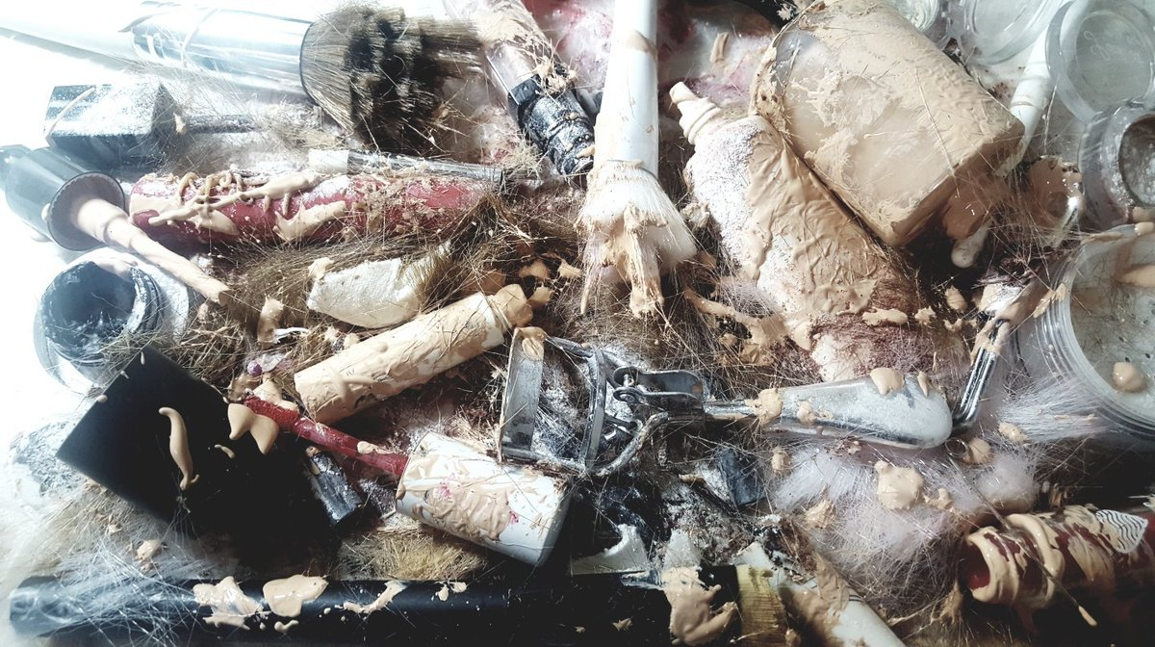
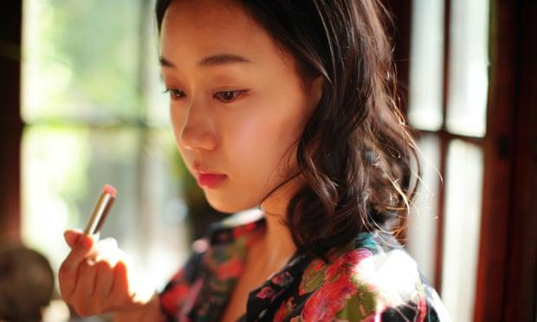
Smashing Makeup -- Persuasion through Code
A backlash against strict beauty standards from south korean woman has been recently going viral
viral videos of women smashing makeup and cutting hair
Ideas:
-Interactive, algorithmic documentary showing beauty trends: Plastic surgery, subway ads, KPOP, 10 step
-Webcam interaction with users to fit face within outlines of “beautiful” faces
References:
Lauren McCarthy, How We Act Together
Ambient Advertisements

Slide 3
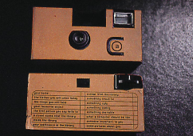
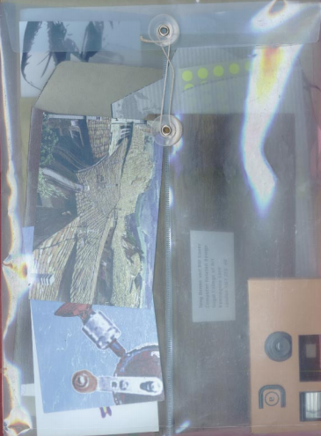
Asian American Artists Interactive Narrative
Explore tension of fusing asian identity with american identity
Create vignettes of different identities using content from cultural probes to set emotional tone of their experiences
Ideas:
-Send cultural probes out to asian american artists like Hellen Jo, Yumi Sakugawa, Chris Chau
-Include camera with shot-wishlist, materials for a archival photo story (6-10 photos that outline your story), map print out with locations that you frequent or want to frequent
References:
-Symphony of Longing by Raycaster Studios
-Cultural Probes by Gaver

Slide 4
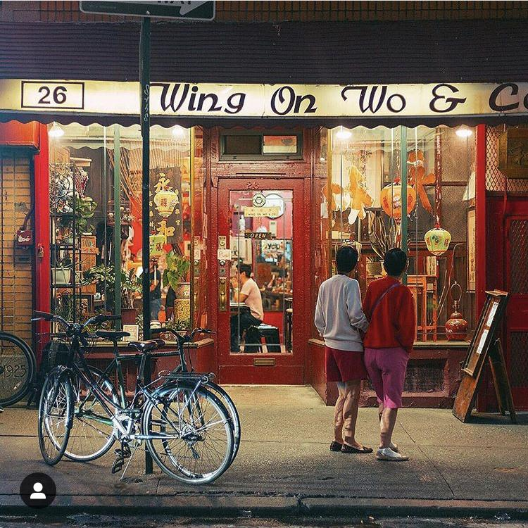
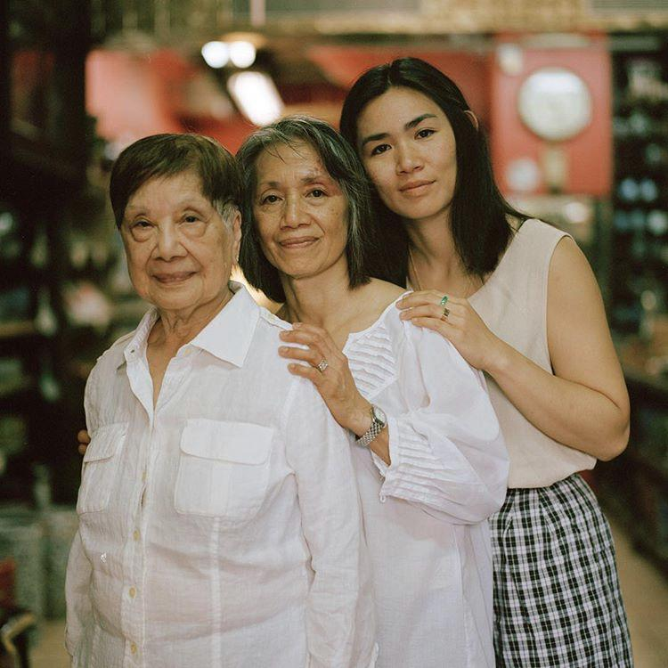
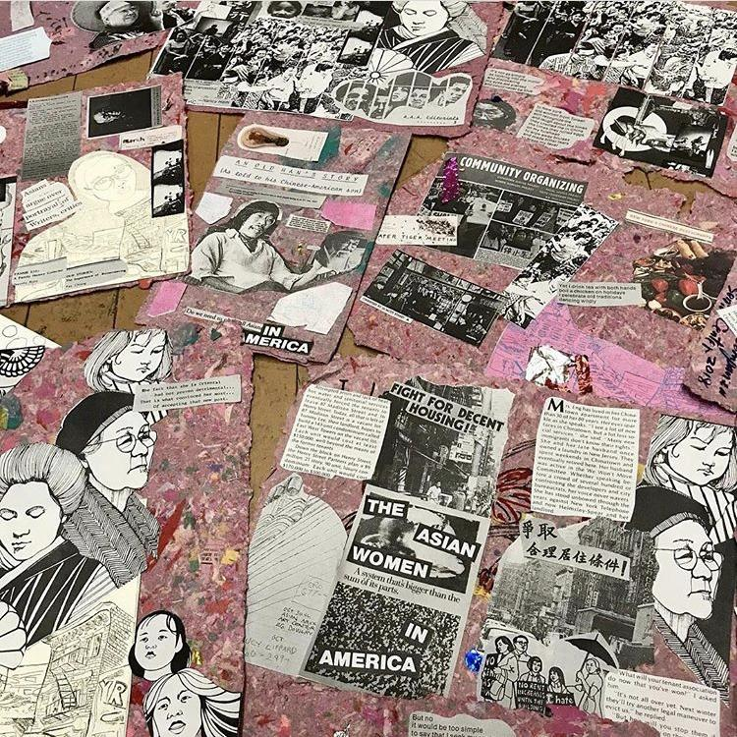
Wing on Wo & Co Interactive Narrative or Persuasion
The oldest operating store in Chinatown, owned by 5 generations.
They’ve started the W.O.W Project in an effort to grow, protect, and preserve “Chinatown's creative culture through arts, culture and activism.”
Ideas:
Can I create an emotional experience, where audience feels connected to the history of WOW and their activist mission?
Themes of gentrification, intergenerational ownership, and cultural preservation
References:
Pre-existing short documentary

Slide 5
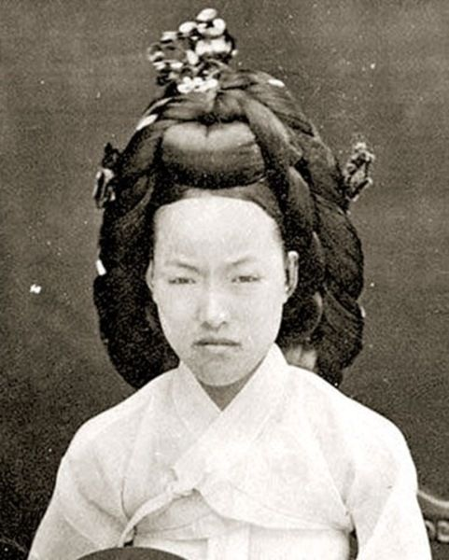
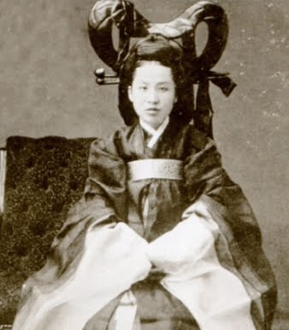
Story of Empress Myeongseong Interactive Narrative
A non-linear documentary about last empress of Korea during Joseon Dynasty.
Background:
-Empress Myeongseong was seen as a threat to expansion by japanese govt because of investing in academics rather than lavish life, taking part in resistance, reading books reserved for men, and taking charge while husband was unsure about political decisions
-She was assassinated by Japanese ronins in 1895, prompting anti-japanese sentiment that still exists
Ideas/Themes:
-cultural preservation/ part of my own lessons in korean history in my effort to reclaim this side of my identity
-images of what it was to be a woman during this time
-intersection of gender, class, and time, and resistance
References:
Chris Marker’s Sans Soleil - experimental film composed of thoughts, images, and scenes.
Youglitch - glitch art as form of resistance
References:
******

